Slide 1
UCSD Embedded RTOS Assignment 3
By
Hsuankai Chang
hsuankac@umich.edu

Slide 2
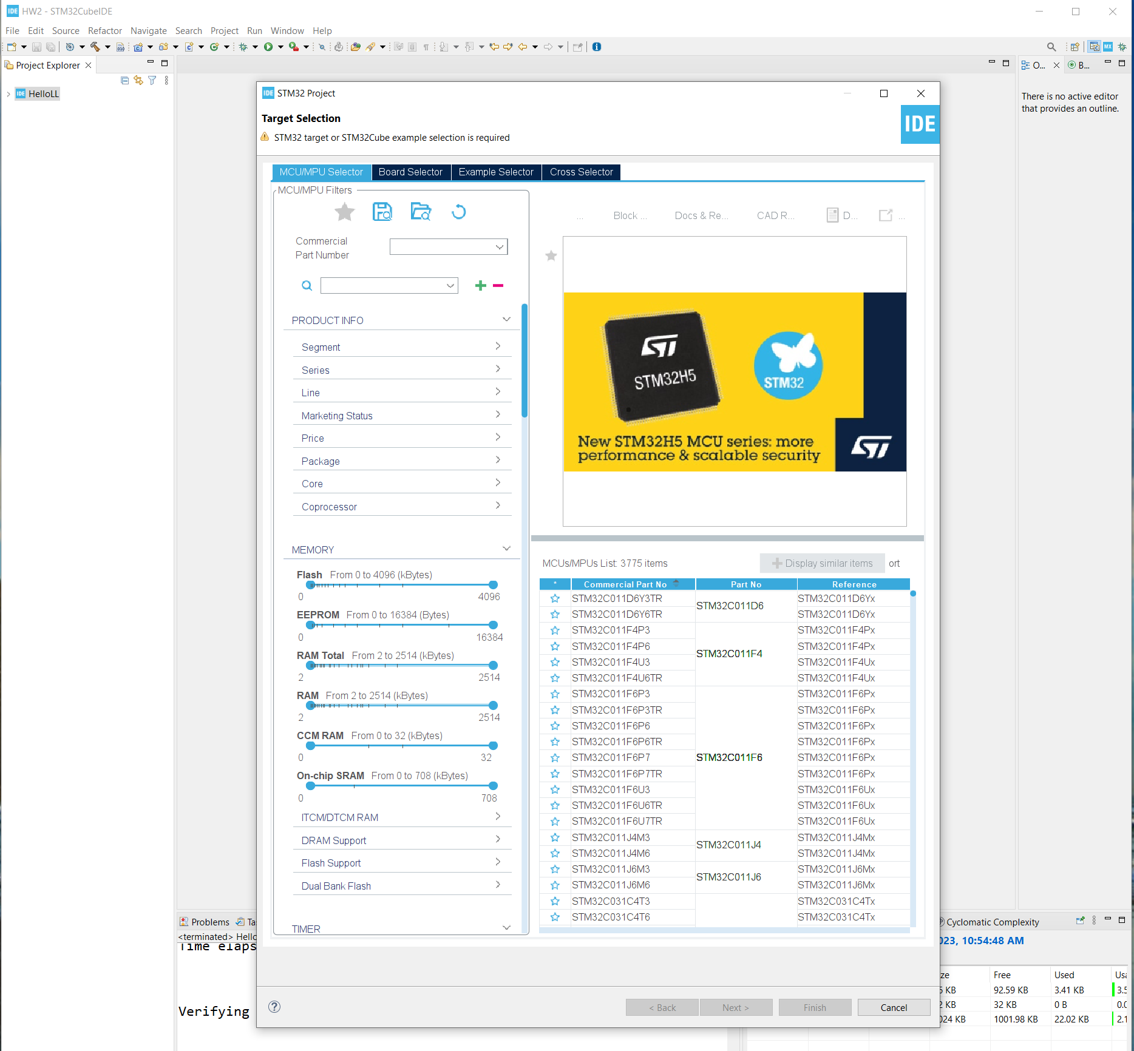
Step 1. Startup STM32CubeIDE and create new STM32 project

Slide 3
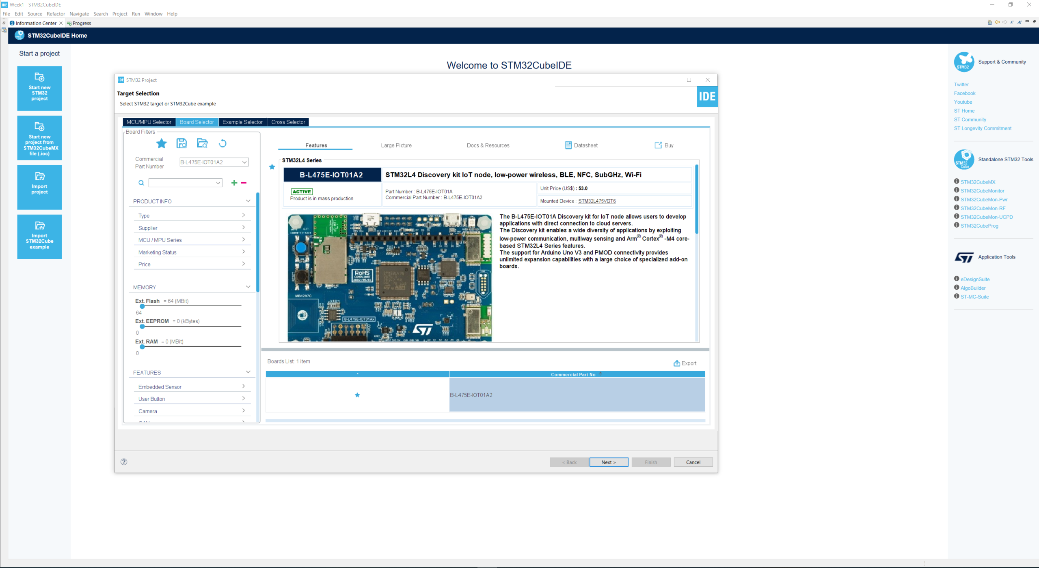
Step 2. Access board selector and type in the board you use, click Next

Slide 4
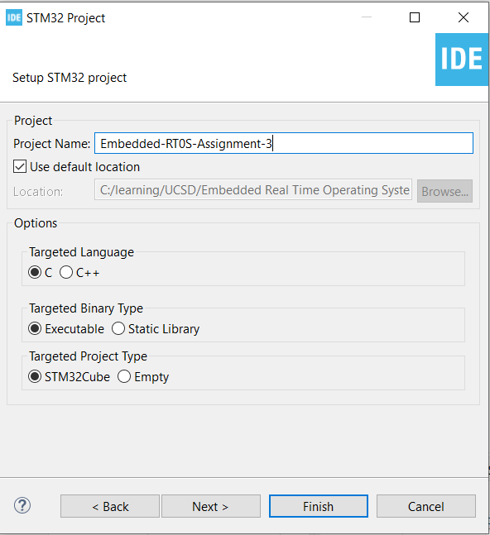
Step 3. Enter the project name then click Next

Slide 5
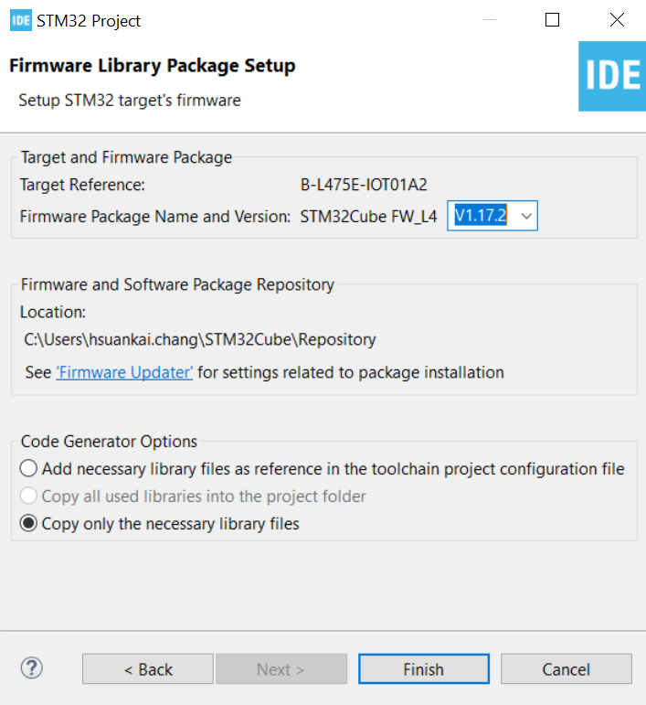
Step 4. See the firmware package name and version

Slide 6
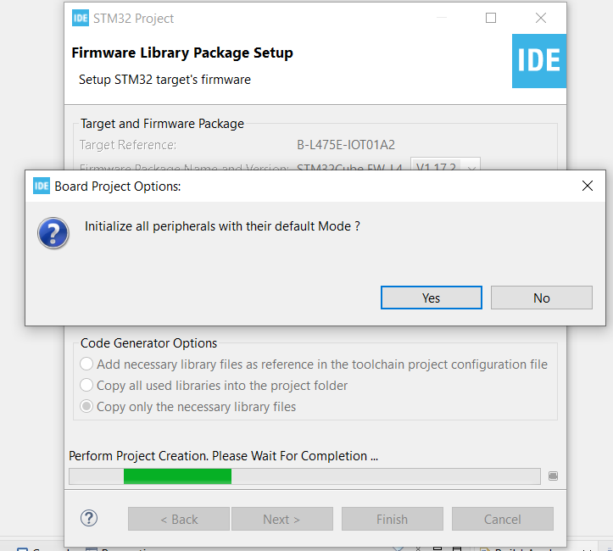
Step 5. Click yes to initialize all peripherals to default

Slide 7
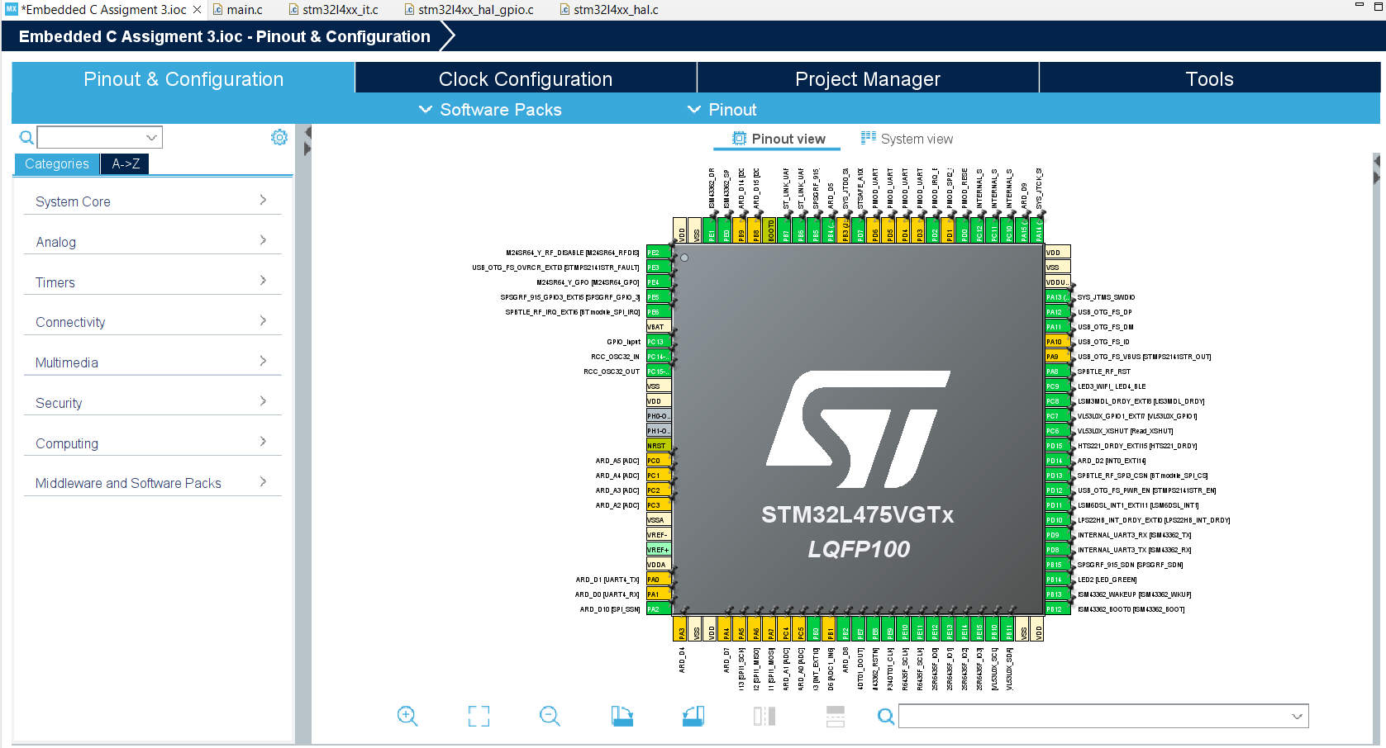
Step 6. When in .ioc file, click Pinout & Configurations

Slide 8
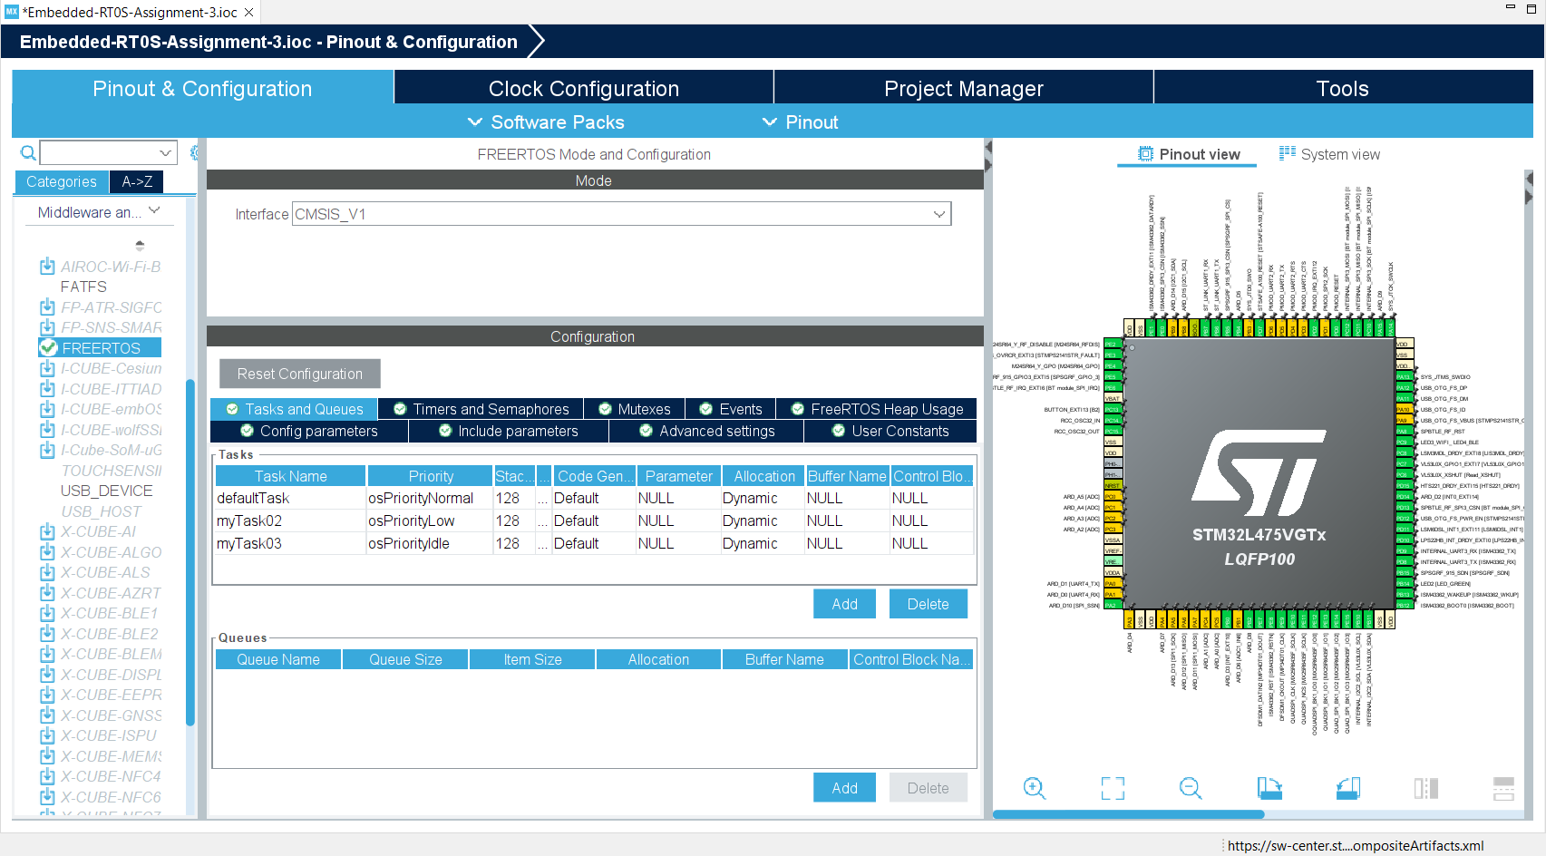
Step 7. Enable the CMSIS_V1 RTOS, and add two more tasks. Set different priority to test

Slide 9
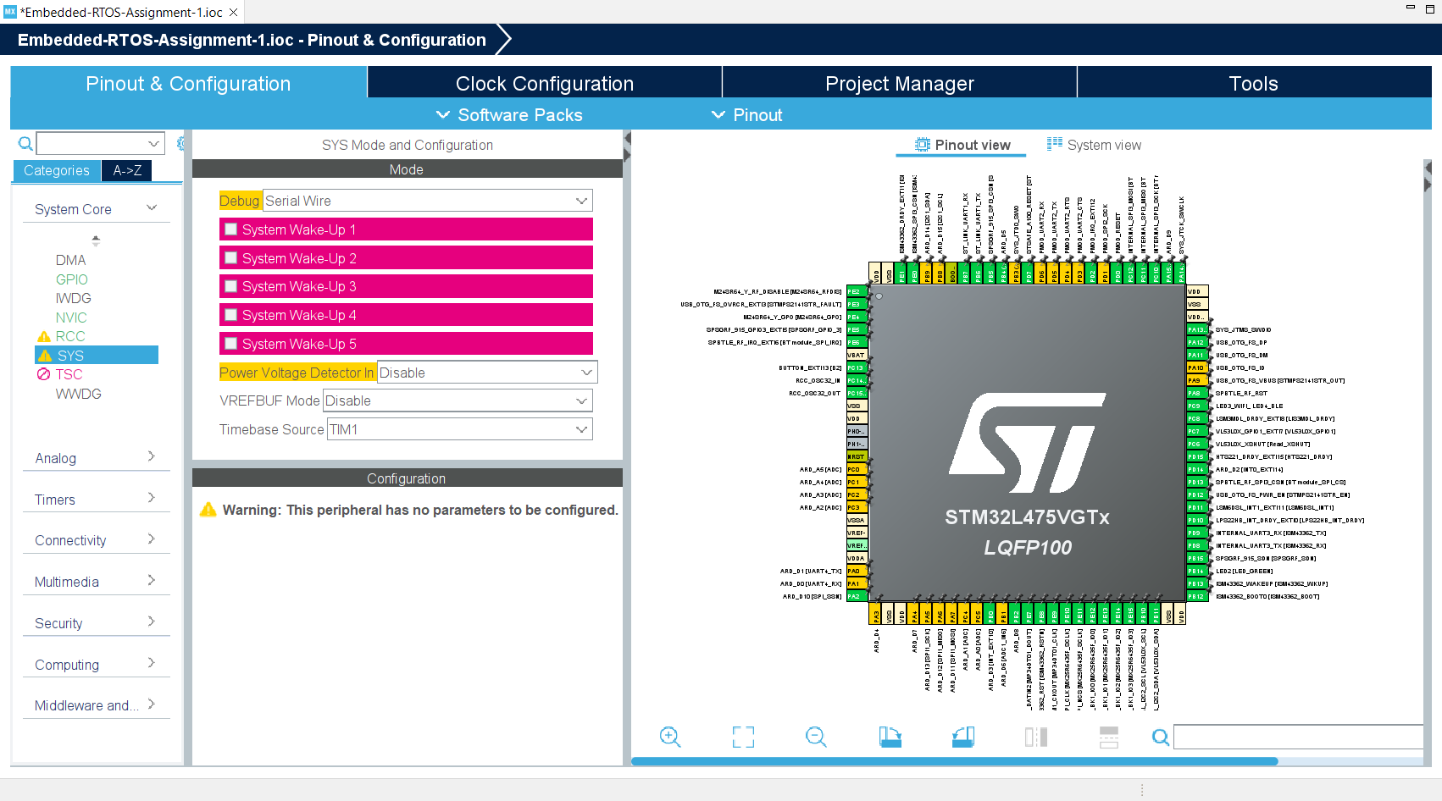
Step 8. Change Timebase from systick to TIM1

Slide 10
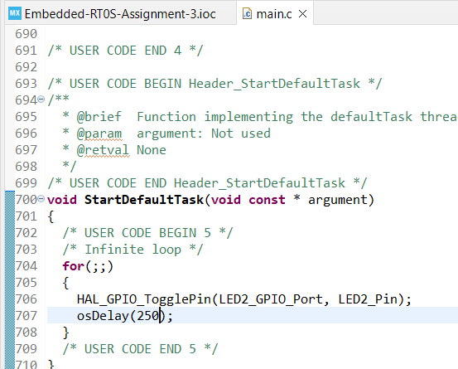
Step 9. In your default task, blink the LED2 every 250 ms

Slide 11
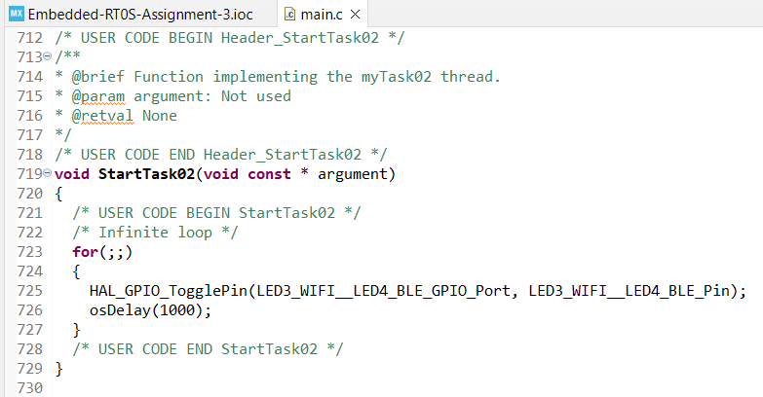
Step 10. In task 2, blinks LED3_WIFI_LED4_BLE every 1000 msec

Slide 12
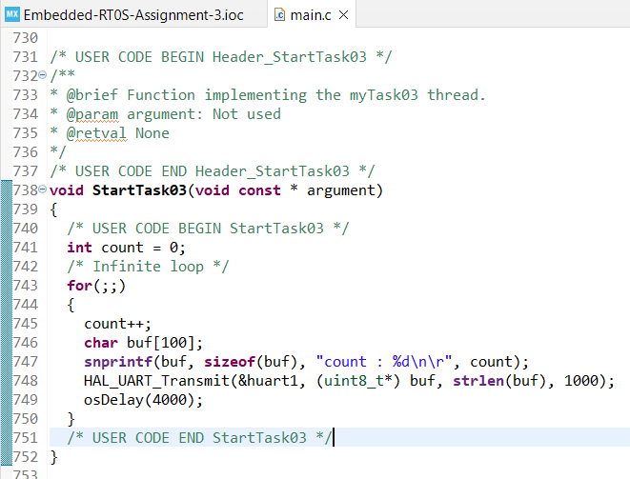
Step 11. Create "Task 3" that displays a counter (e.g. "count = 1", "count = 2", etc.) on the STM32 Virtual Console.

Slide 13
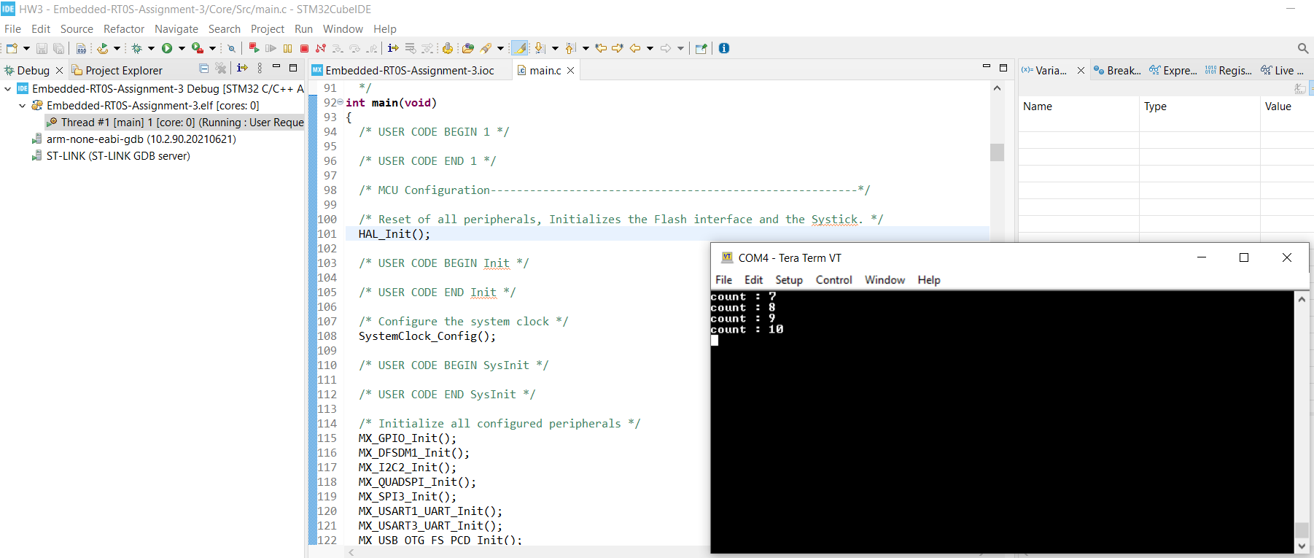
Step 12. Debug and run the code, you can see LED2 and LED3 blinking, and console prints out the desired message

